Slide 1
“The Water Czar”
Who? What? Why?

Slide 2

VALVE STATIONS
CAROL
PAUL
COST
TOILET LEAK
BUDGET
DROUGHT
40,000 GALLONS
GRASS
SPRINKLERS
DRIPS
SUE

Slide 3


NO!
&
IS IT REALLY THIS HARD??

Slide 4
UNDERSTAND “YOUR HOA”

Slide 5
DEMOGRAPHICS
# OF VALVE STATIONS
# OF WATER METERS
MULTI FAMILY HOMES – DUO,TRI,QUAD
SINGLE FAMILY HOMES
BILLING TYPE
WATER COMPUTERS
DRIP SYSTEMS

Slide 6
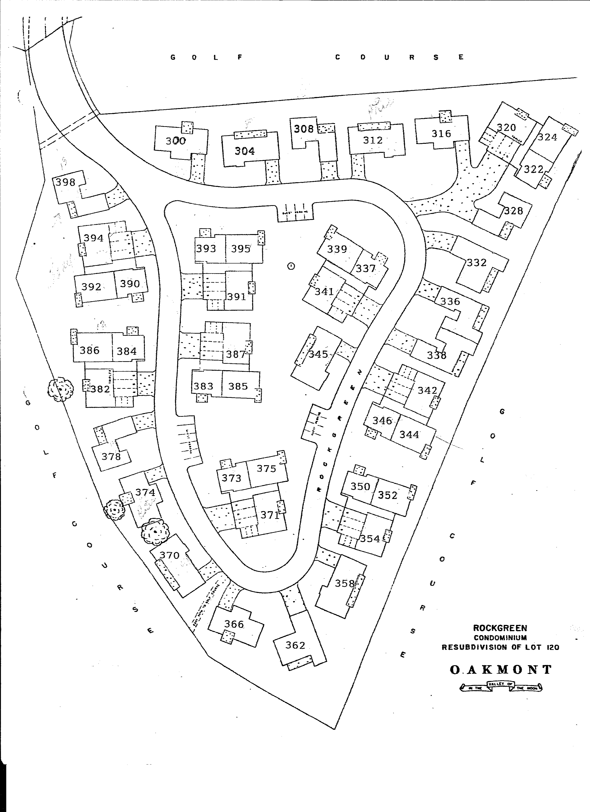

DRIP
COMP
DRIP
DRIP
DRIP
DRIP
DRIP
COMP
VS
COMP
DRIP
DRIP
DRIP
DRIP

Slide 8
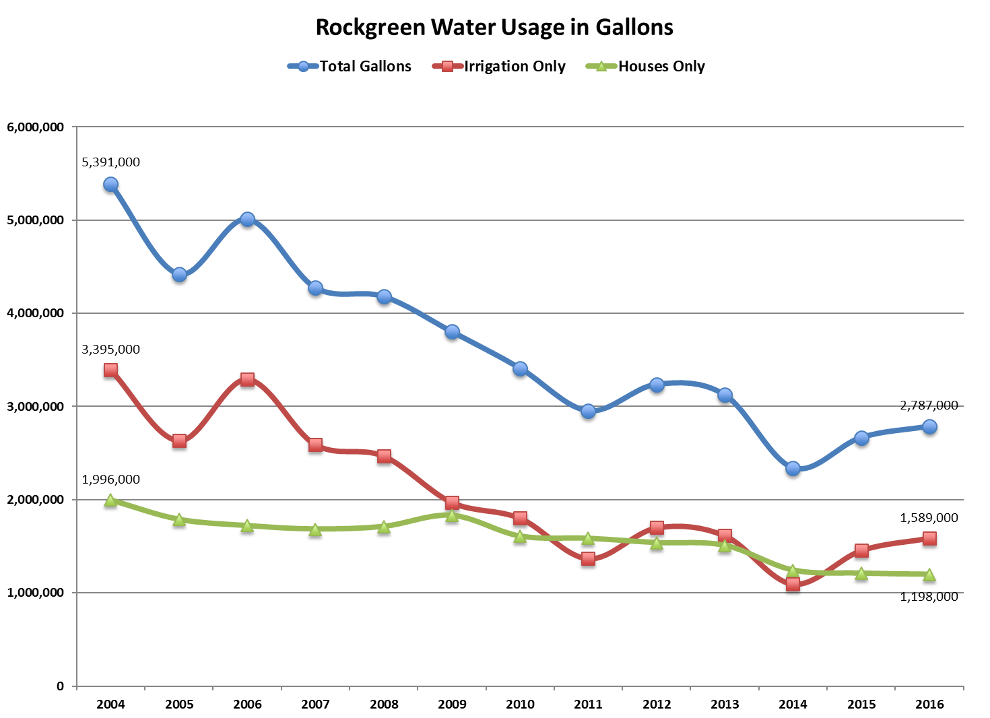

Slide 9
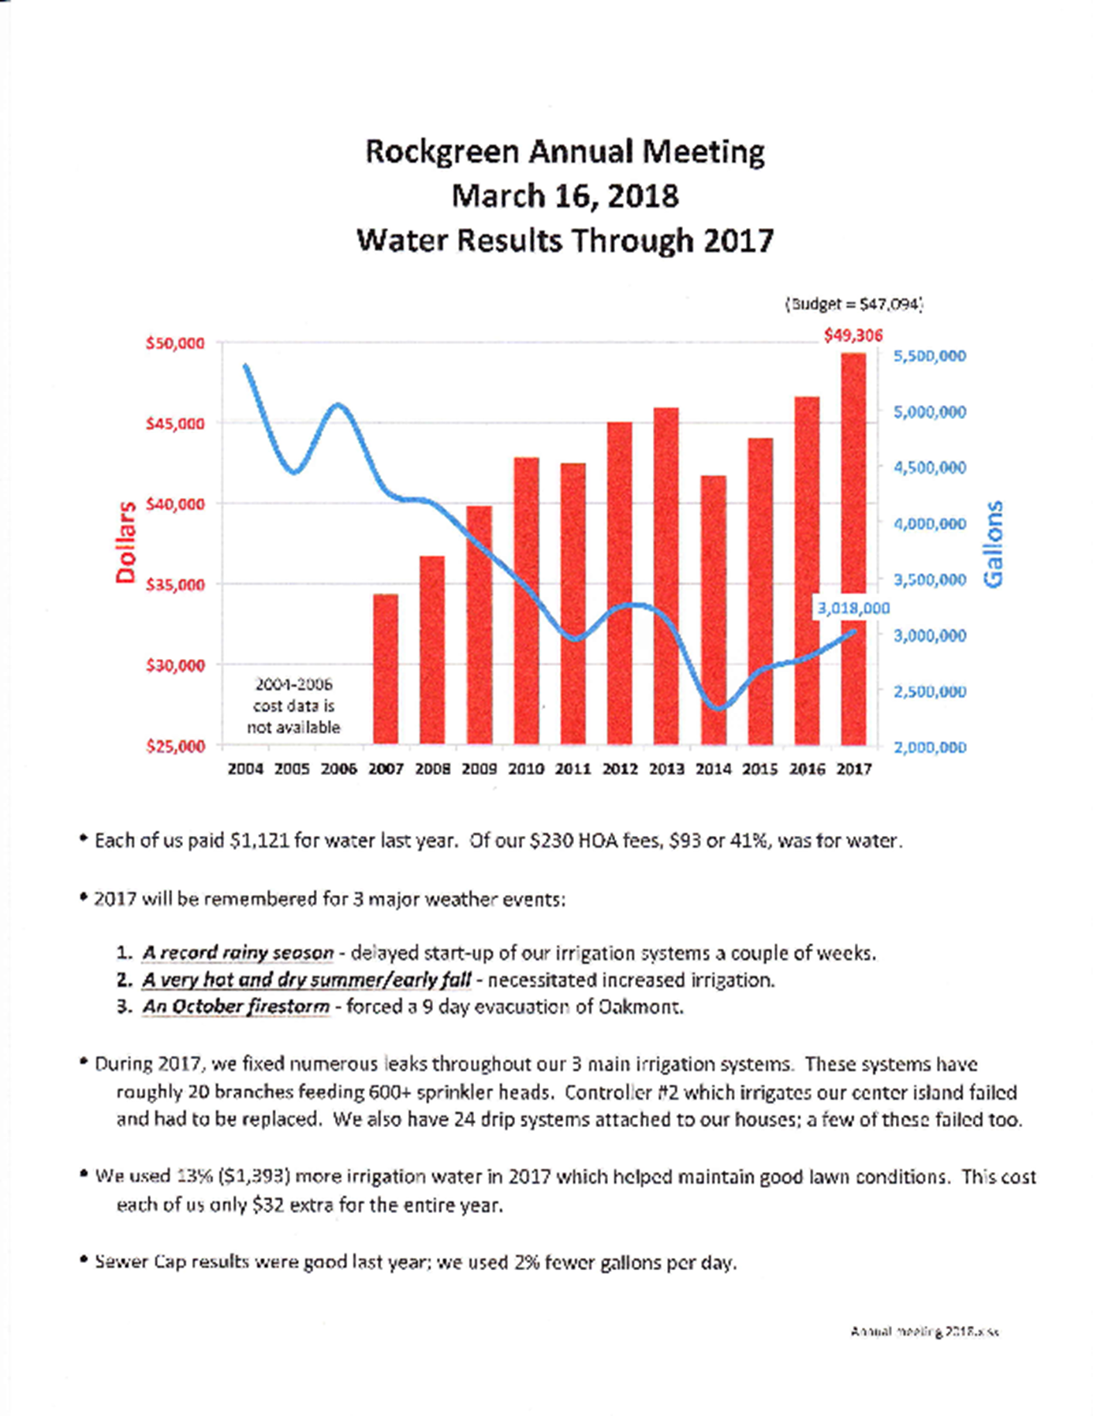

Slide 10
BUDGET

Slide 12


Slide 13

42%

Slide 14
DRIP SYSTEMS
&
SPRINKLERS

Slide 15
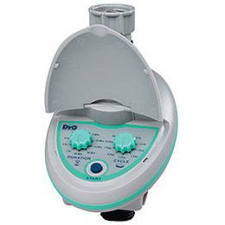
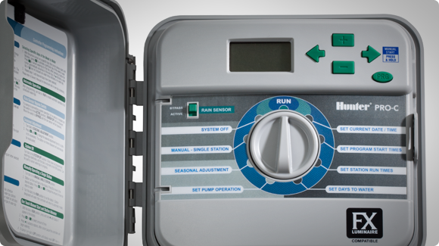

Slide 17
SEWER CAP

Slide 18
ANALYZE
“YOUR HOA”

Slide 19
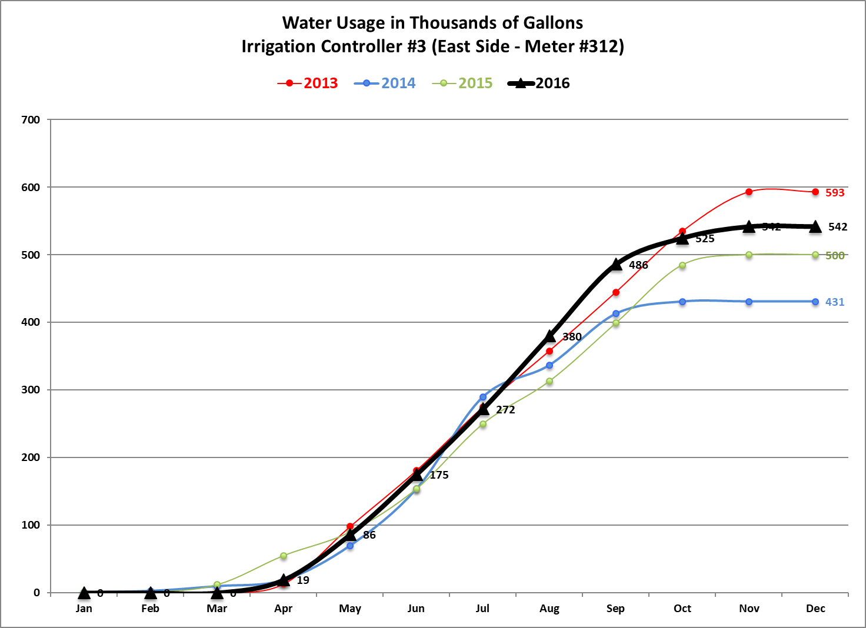

Slide 20
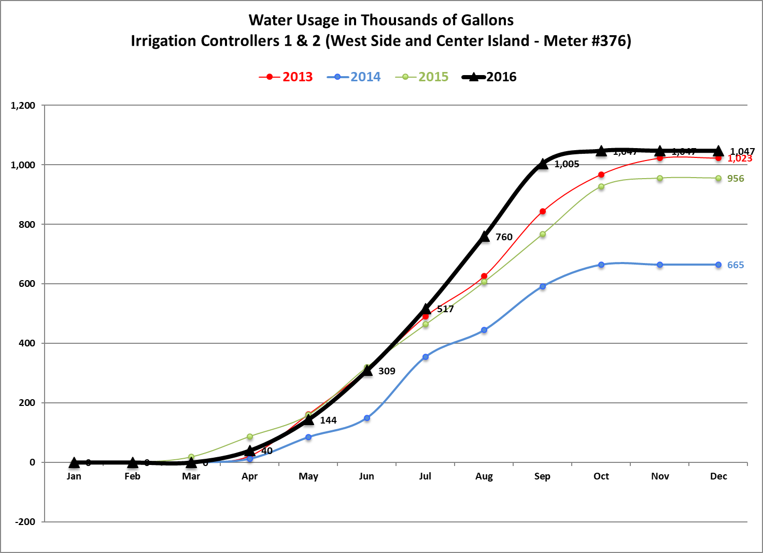

Slide 21
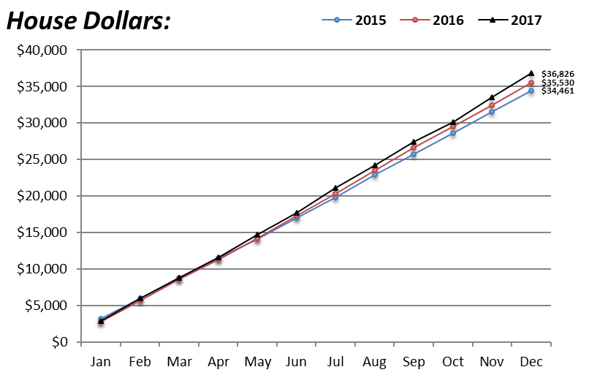

Slide 22
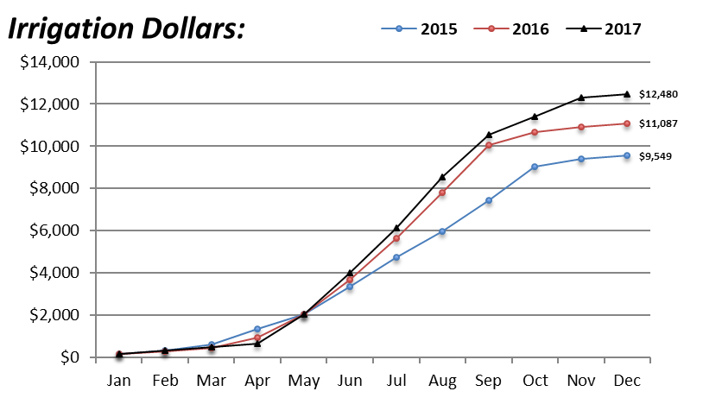

Slide 23
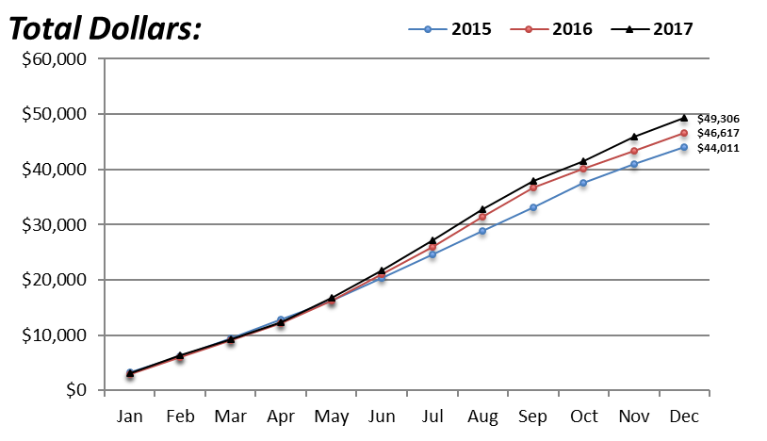

Slide 24
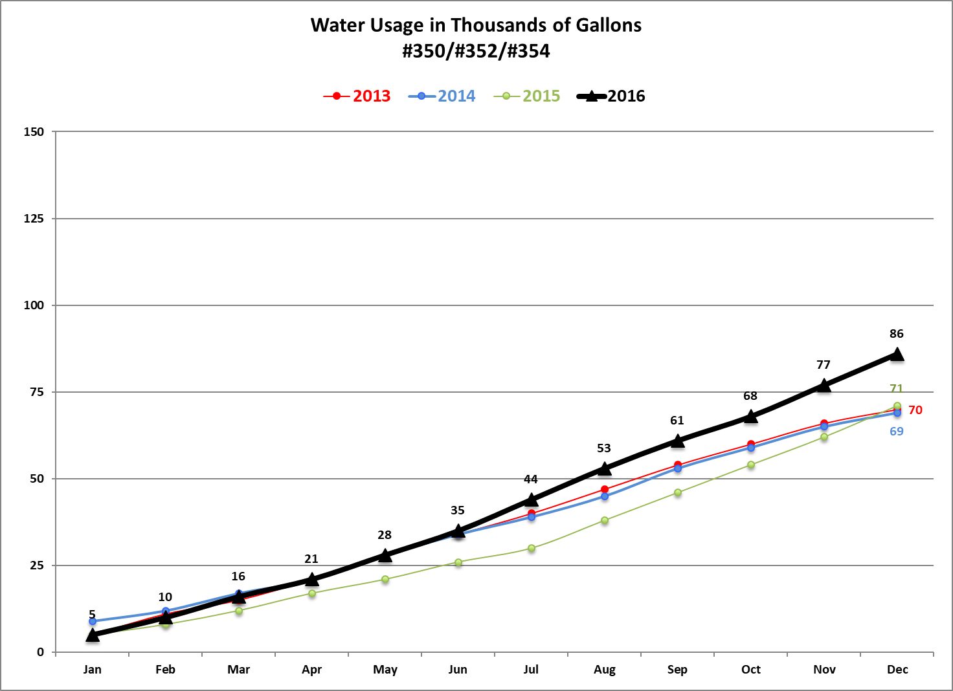
PROBLEM OR NO PROBLEM??

Slide 25
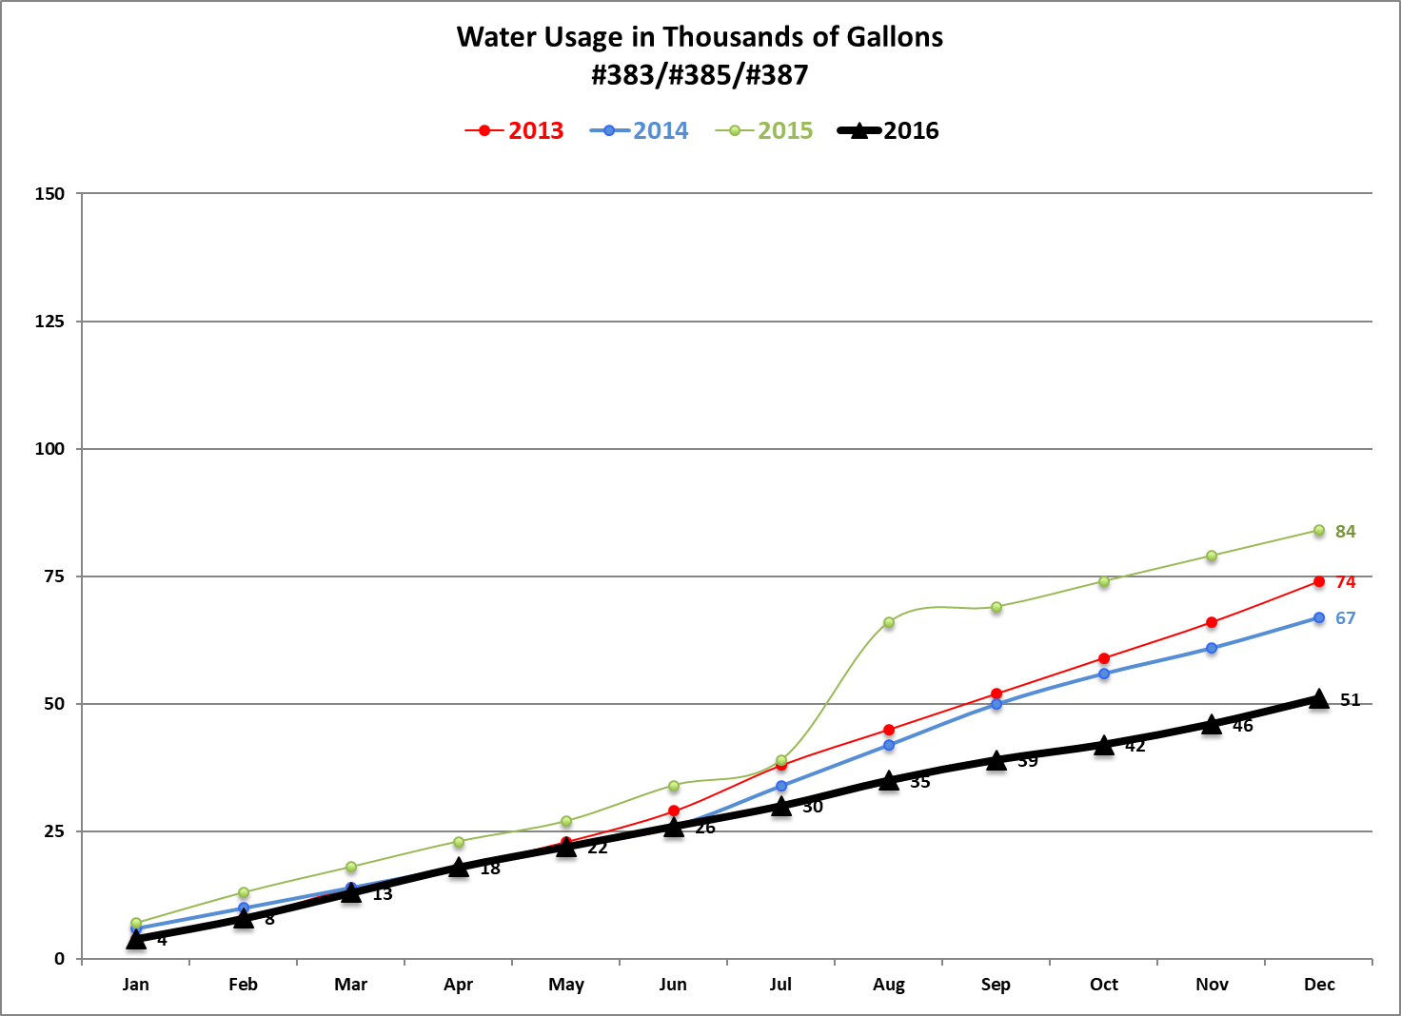
*** BOARD NOTIFICATION TO OWNER

Slide 26
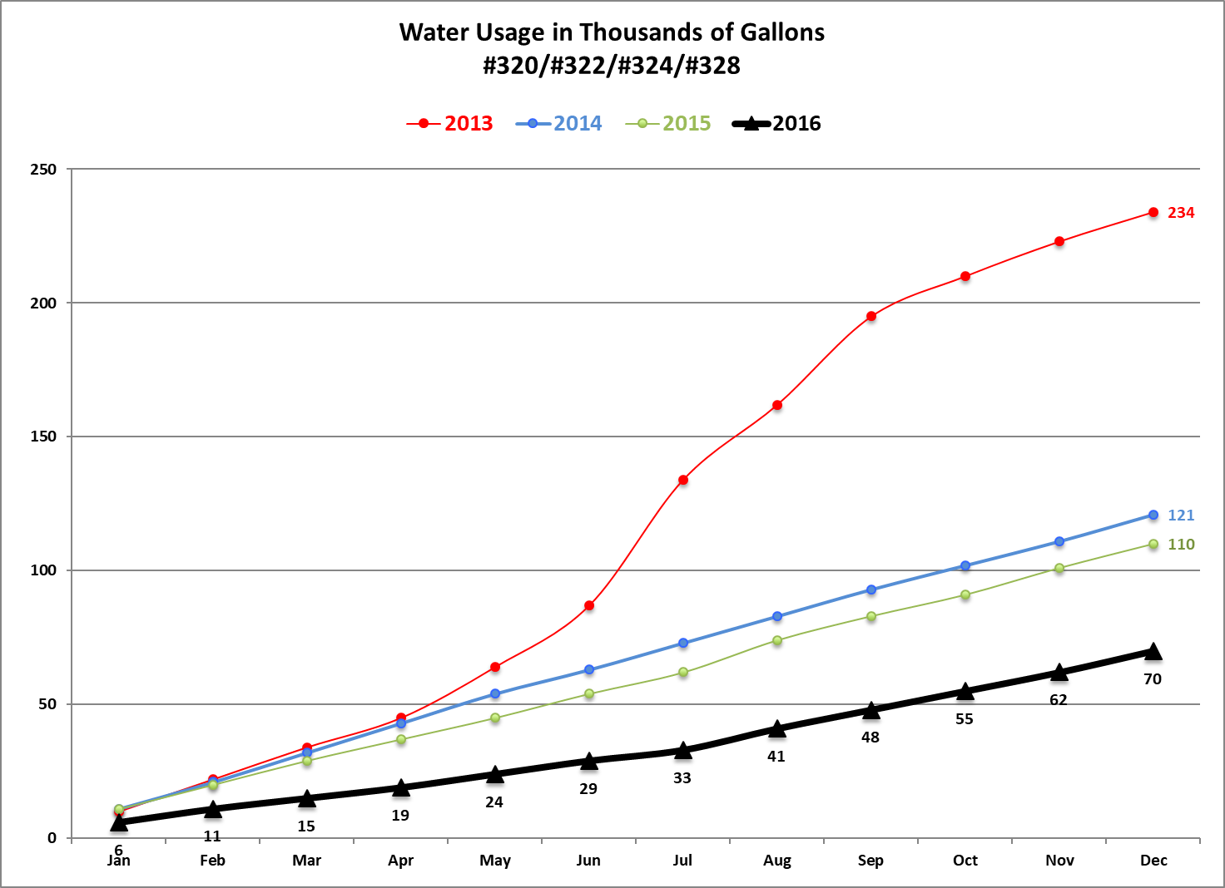
*** CITY NOTIFICATION TO OWNER
DESERT COOLER A/C

Slide 27
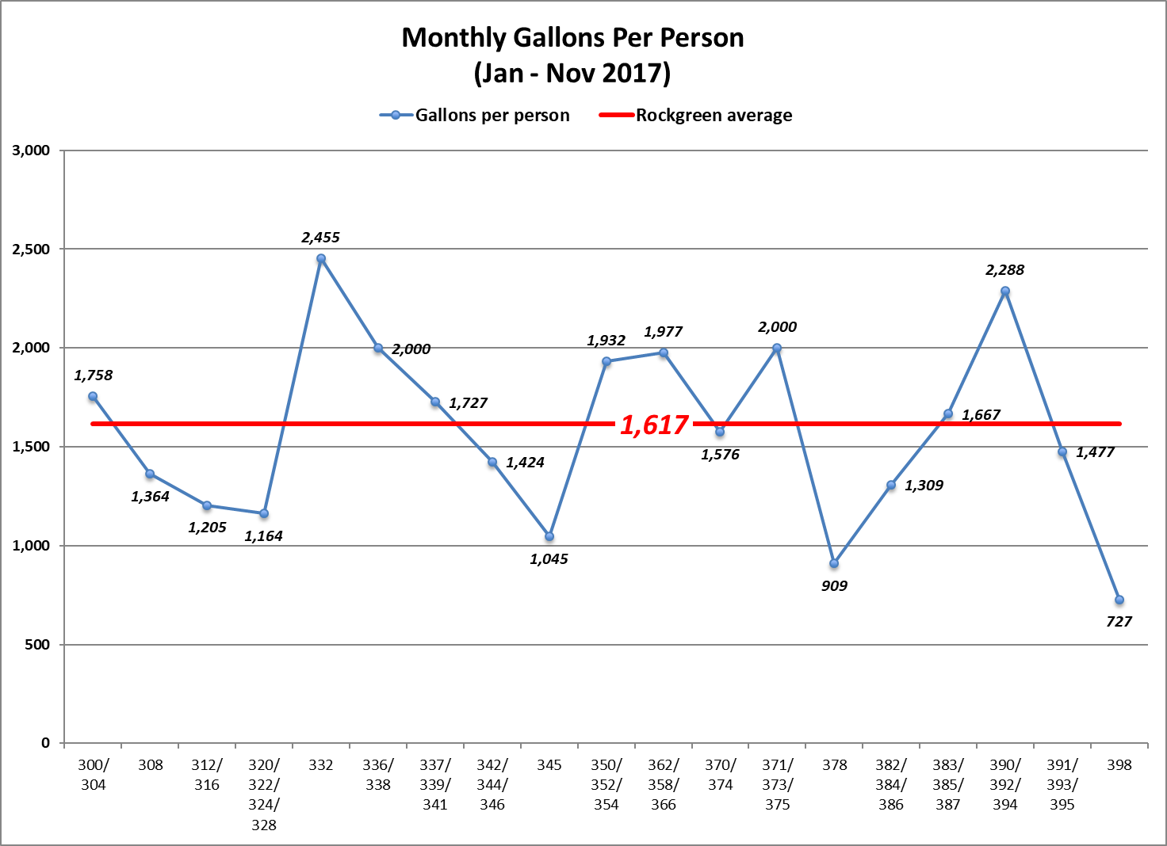

Slide 28
UNDERSTAND AND EMBRACE
BUDGET PROPERLY WITH DATA
MONITOR
STAY FLEXIBLE
TEST SYSTEMS
STAY AHEAD
PROOF THE BILLS
HIGH RATES VERSUS USAGE
BACKFLOW TESTING

Slide 29
WHY??
$$,$$$
CONSERVATION
IRS 70-604

